Slide 1
Defensive Coding
Carlos.Leigue@Jalasoft.com

Slide 2
Agenda
Asserts
Errors
Exceptions

Slide 3
Defensive Coding
Asserts
Asserts provide issue notifications to developers when building, testing and maintaining code
Assertions help us document assumptions (invariants)
Invariants are conditions that we can assume as true during an execution, expected state of class data
Assertions are warnings for developers, raised at runtime in debug mode

Slide 4
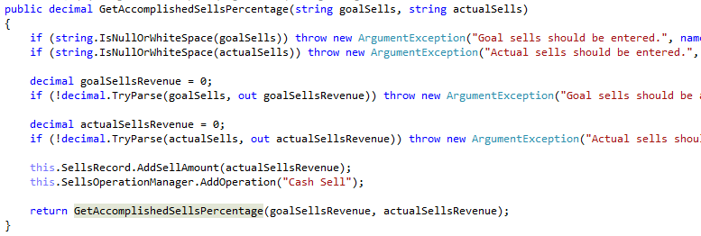
Defensive Coding
Asserts
invariants

Slide 5
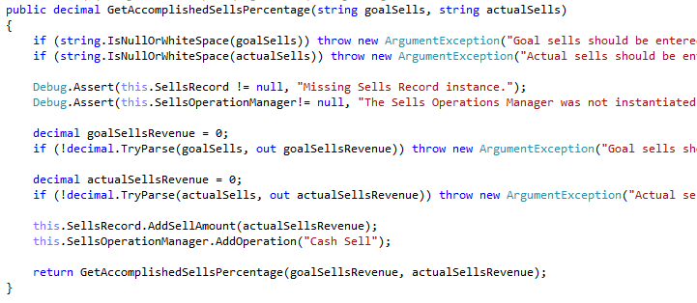
Defensive Coding
Asserts
assertions

Slide 6
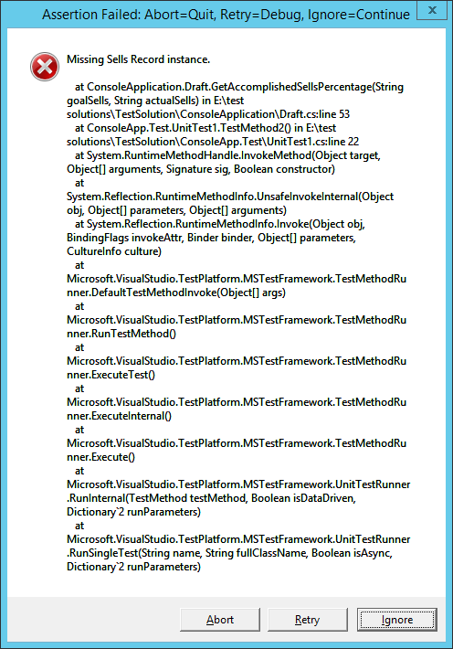
Defensive Coding
Asserts

Slide 7
Defensive Coding
Errors
Anticipated issues and exceptions
User entry errors
Invalid or missing data
Code construct issues
System issues
Use restrictive controls and bindings
Use validation methods
Use good defaults
Throw exceptions
Notify the user only when necessary with understandable statements

Slide 8
Defensive Coding
Errors
User entry errors
Use of appropriate controls
i.e., RadioButton, ComboBox
Built in data validation
i.e., Masks
Implement custom validation method
Validate with guard clauses
Proceed with default values
i.e., Empty first name

Slide 9
Defensive Coding
Errors
Invalid or missing data
Validate incoming data
i.e., guard clauses, complex validations
Proceed without the value
i.e., no mail address, procced as it is not mandatory
Proceed with default values
i.e., continue using a valid default
Throw an exception or return an error object to display a message to the user

Slide 10
Defensive Coding
Errors
Code construct issues (flow of control)
Proceed with default operation
i.e., the default case of a SWITCH
Ignore the issue
i.e., proceed as it is not a showstopper
Log the error and display a message to the user

Slide 11
Defensive Coding
Errors
System issues
Try again
i.e., retry after a while, repeat until some condition
Proceed with a default or alternate operation
i.e., no implementation for a case, proceed with a standard
Ignore the issue
i.e., proceed anyway
Log the error and display a message to the user

Slide 12
Defensive Coding
Exceptions
Unexpected issues, unhandled exceptions
Even using all the defensive techniques, bugs happen
Dropped connections
DB errors
Unexpected system exceptions

Slide 13
Defensive Coding
Exceptions
Global Exception Handler
Handler that catches any exception raised by the application
We should rely on this only to handle unexpected issues

Slide 14

Defensive Coding
Exceptions
Global Exception Handler for a Console Application

Slide 15
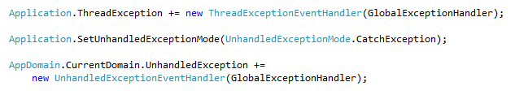
Defensive Coding
Exceptions
Global Exception Handler for WinForms

Slide 16
Defensive Coding
Exceptions - Handling
Anticipated (expected) Exception Handling
Do not use the global exception handler
Handle exceptions locally
Always do something in the catch block
Do not use a try-catch block unless you are going to do something useful in the catch block
Catch specific exceptions
Log information about the exception
Don’t try-catch everything, catch only the expected

Slide 17
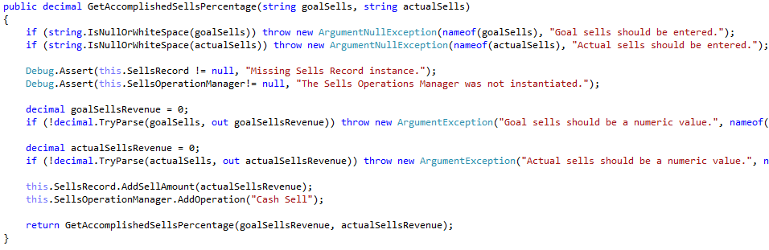
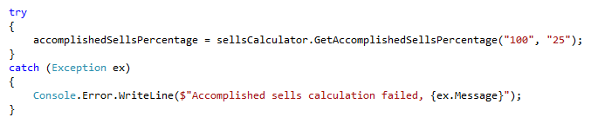
Defensive Coding
Exceptions - Handling
Handle locally
exception thrown
exception caught

Slide 18
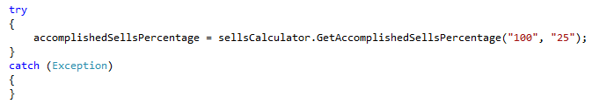
Defensive Coding
Exceptions - Handling
Always do something
log the error, display an error to the user
return an expected/default value
act according to your needs
after doing something, re throw?

Slide 19
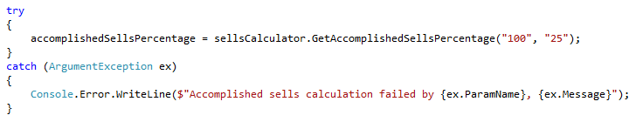
Defensive Coding
Exceptions - Handling
Catch specific exceptions
general exception
specific exception

Slide 20
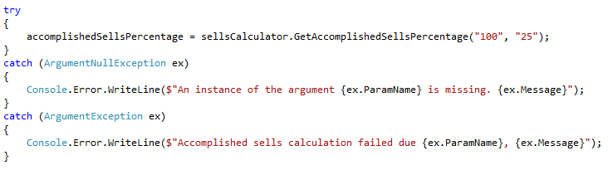
Defensive Coding
Exceptions - Handling
Multiple catch blocks for a try

Slide 21
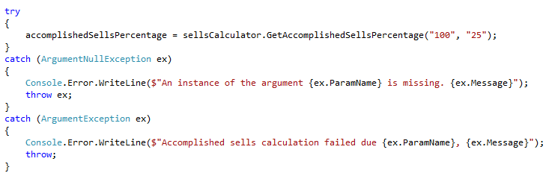
Defensive Coding
Exceptions - Handling
Do not use: throw ex, just throw

Slide 22
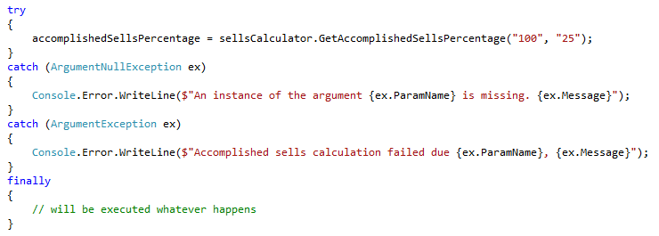
Defensive Coding
Exceptions - Handling
Use a finally block when needed

Slide 23
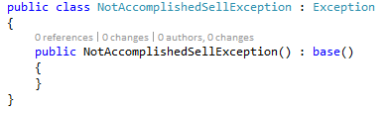
Defensive Coding
Exceptions - Handling
Extend your Exceptions

